Slide 1


Welcome
Making lunchtime the highlight of your day

Slide 2
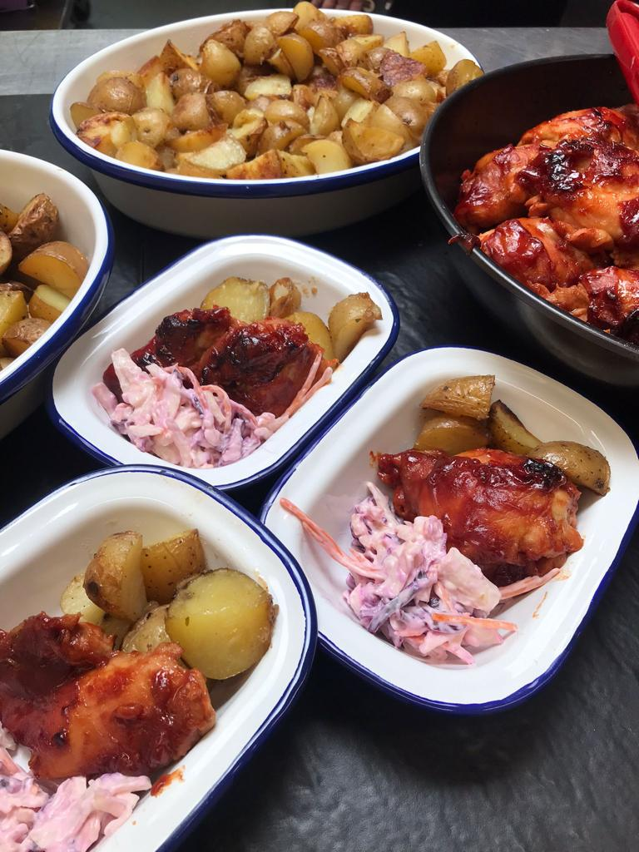
Our Food and Values
Food will always be at the heart of everything we do. It starts with quality ingredients that include Red Tractor Meat, Free Range Eggs & MSC sourced Fish that is prepared and cooked by people who love what they do. All our food is freshly cooked with ingredients from trusted suppliers. Your students and parents can be assured that we are serving great quality food that will help them grow and learn.

Slide 3
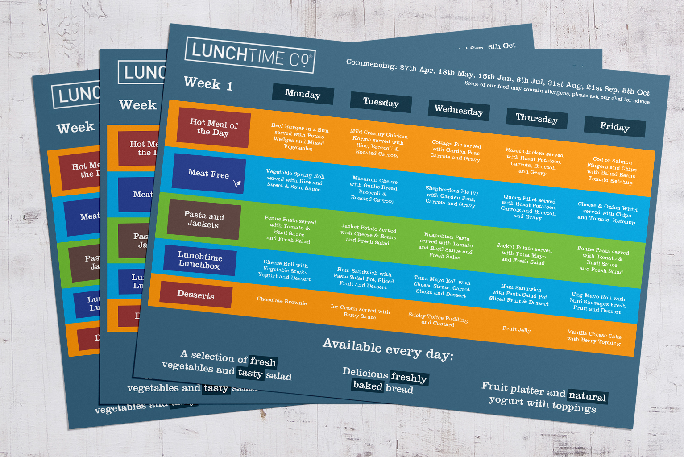
Our Menus
Our menus are nutritionally balanced and compliant with the school food plan
Fresh Salad, Yogurt and Fruit is available every day for the children
Reduced salt and sugar in our recipes
Fresh vegetables served daily

Slide 4
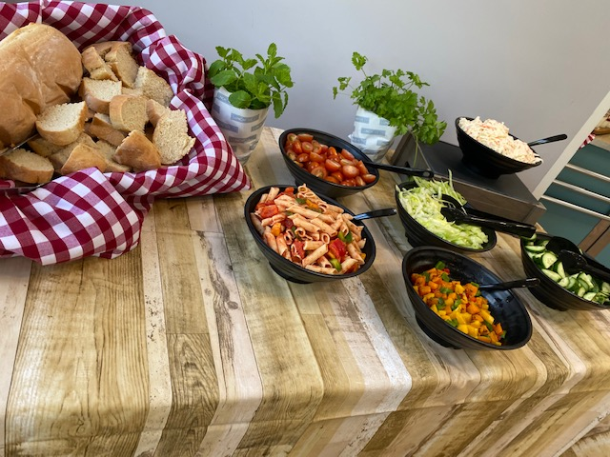
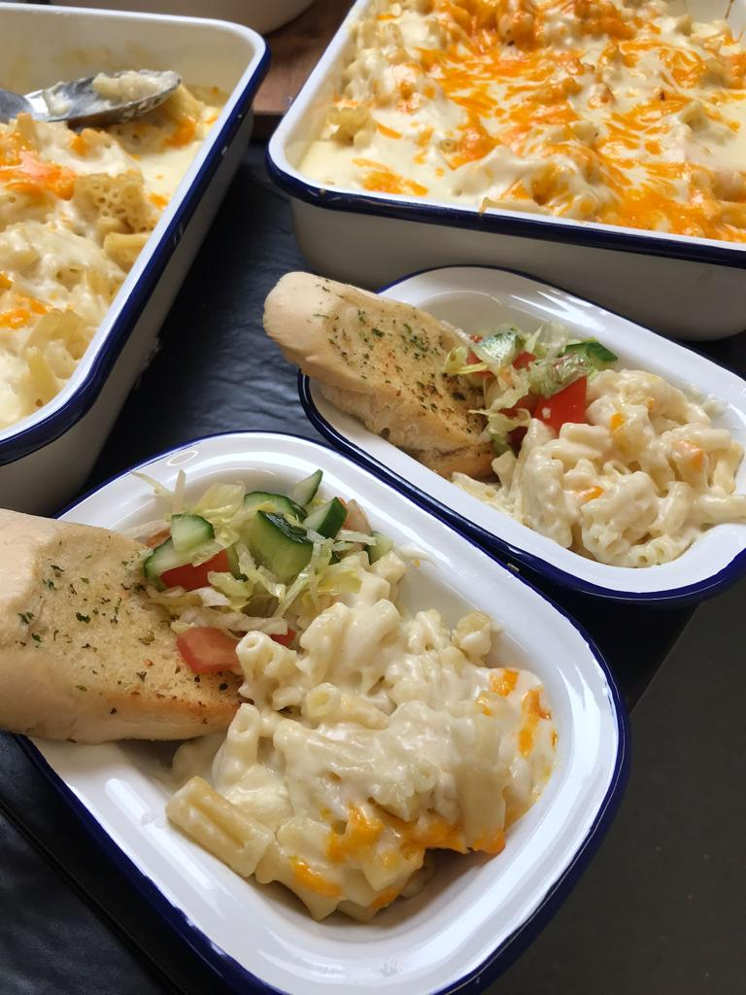
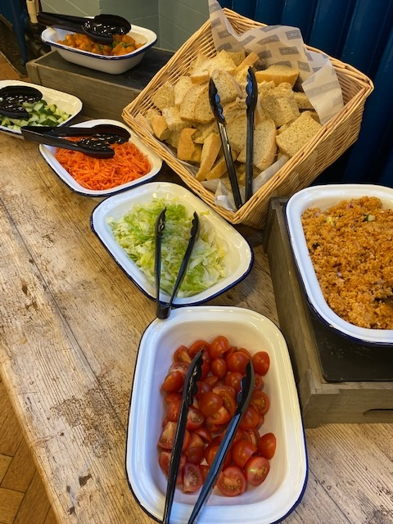
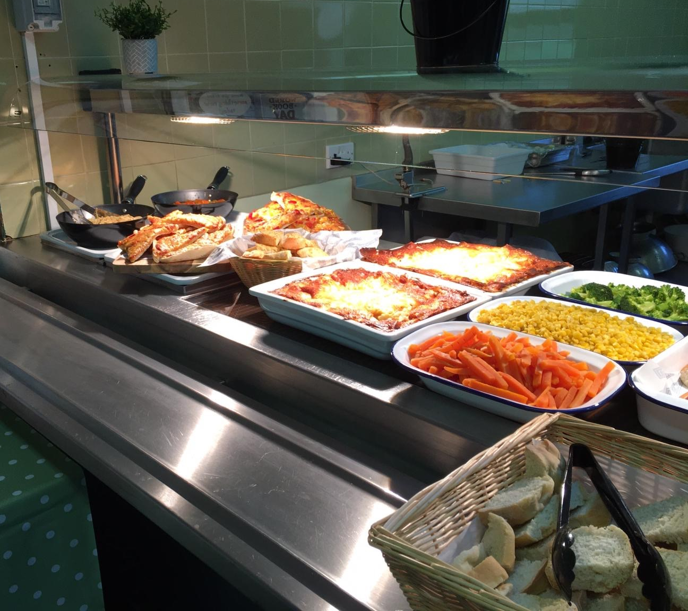
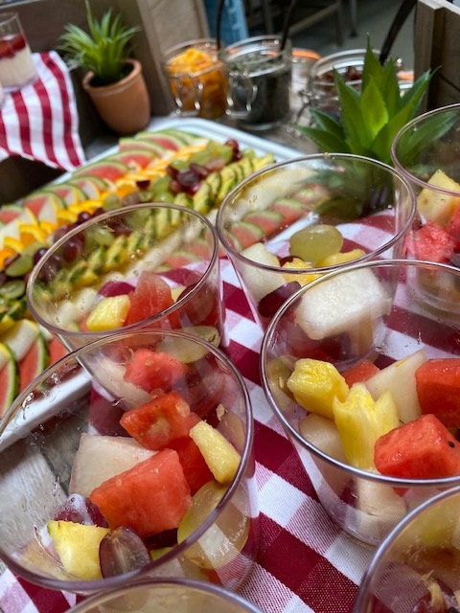
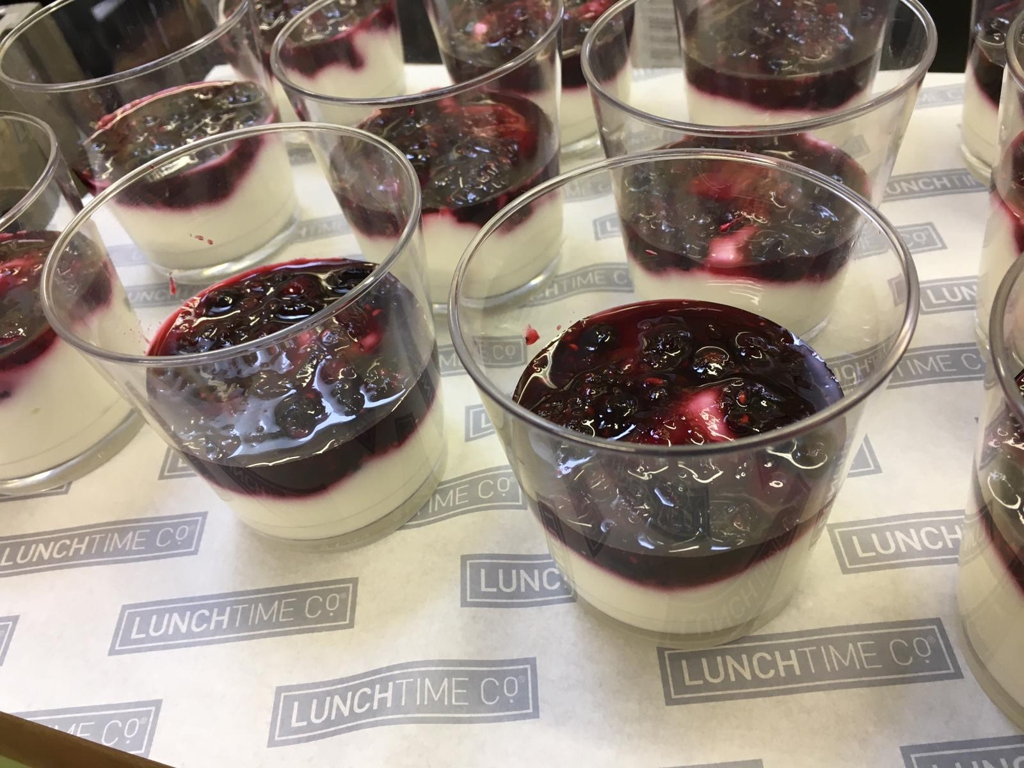
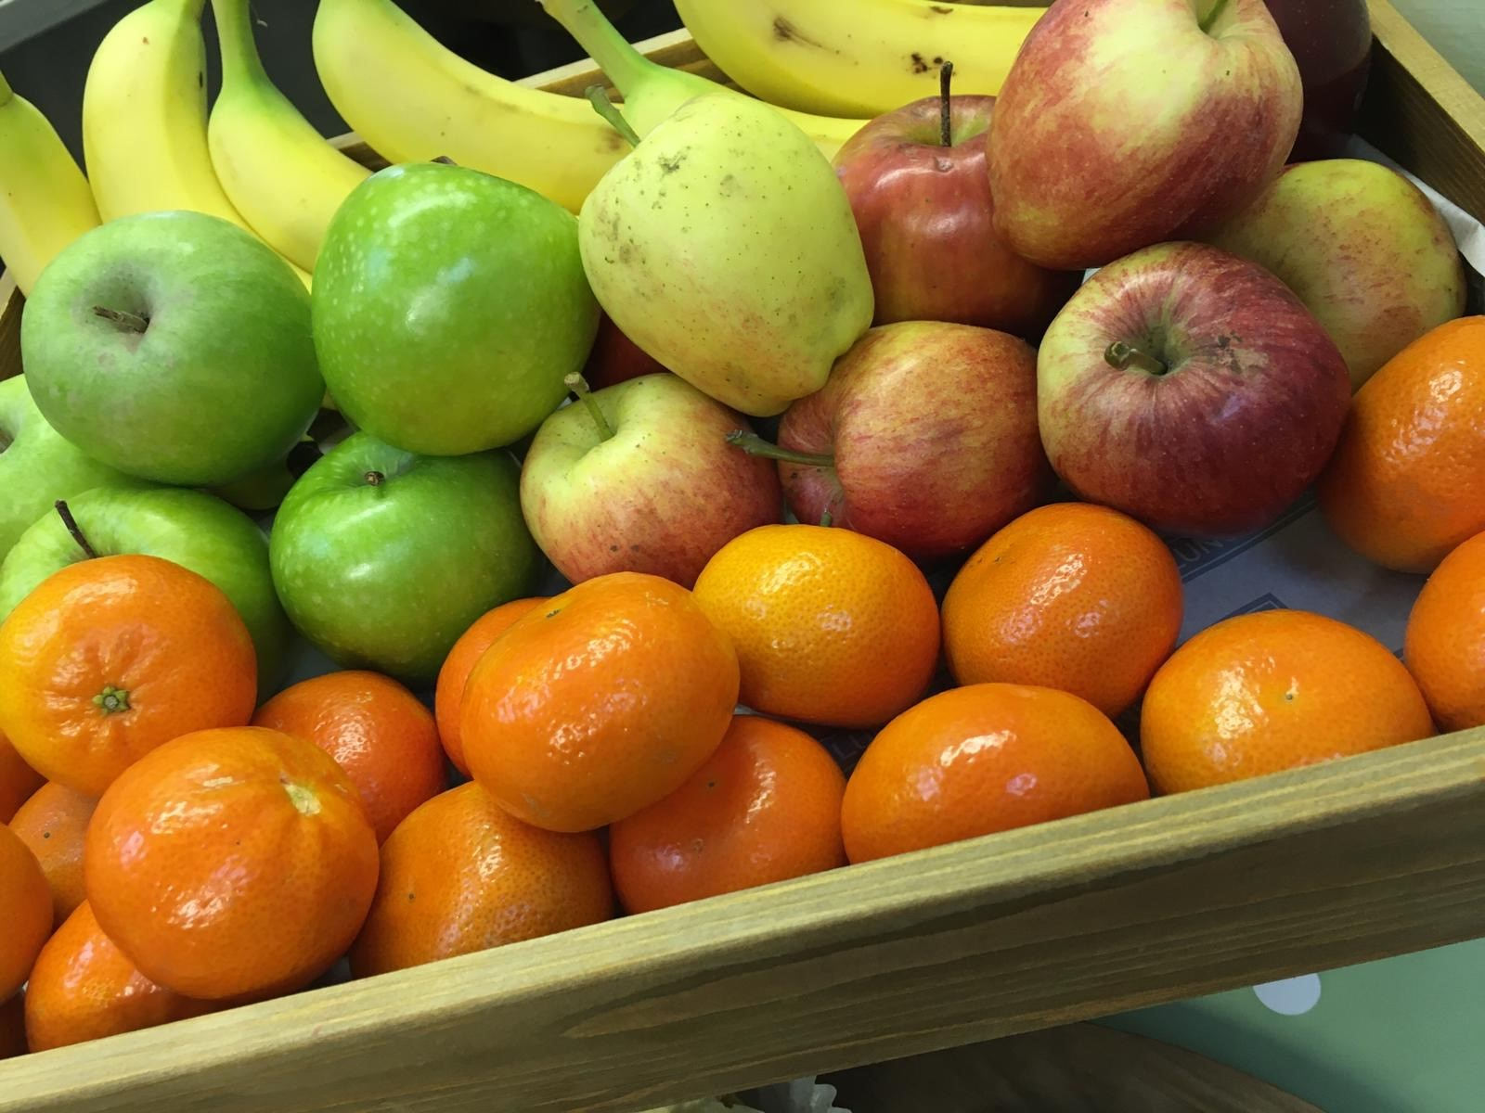
Our Food
Salad Bar available each day
*or mixed salad for our smaller schools
Freshly Baked Bread available daily
Fresh Fruit Platter or Fruit Pots available each day
Fresh Vegetables served with our main meals
Yogurt with Fruit Coulis available each day
Lunchtime Lunchbox available
Meat Free options available
Jacket Potato and Pasta Options

Slide 5
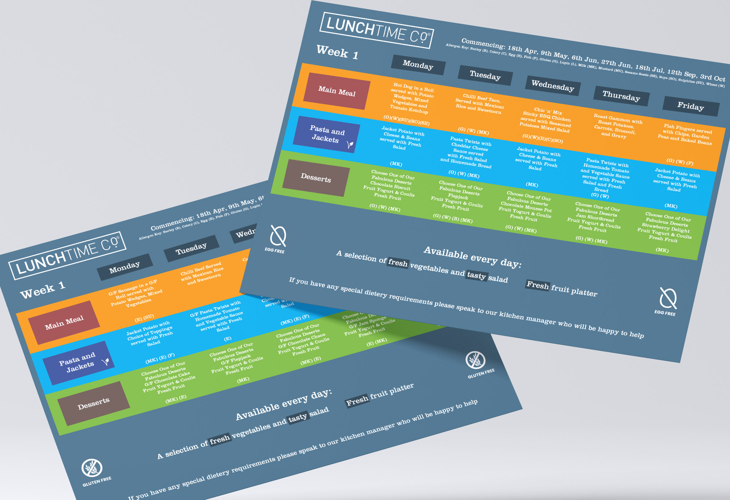
Medical Diets and Allergies
Lunchtime Co. Menus follow the school Food Standards and we aim to cater to the majority of school students. We are aware that not everyone is able to eat all foods safely. If a child has a medically diagnosed allergy or intolerance or health condition, we work with parents/guardians and health professionals to develop an individual menu for your child.
For the most common allergy and intolerances, menus are available for Gluten Free, Dairy Free, Egg Free and Soya Free.
All our schools have a nut free policy
Menus have allergen information for the complete meal stated on them
An allergen matrix is available in all kitchens
Contact the school if your child has a medical diet and we will work hard to provide a suitable menu wherever possible.
Our Kitchen Managers and Operations Team are happy to meet a parent with any concerns regarding medical diet requirements for their child.

Slide 6

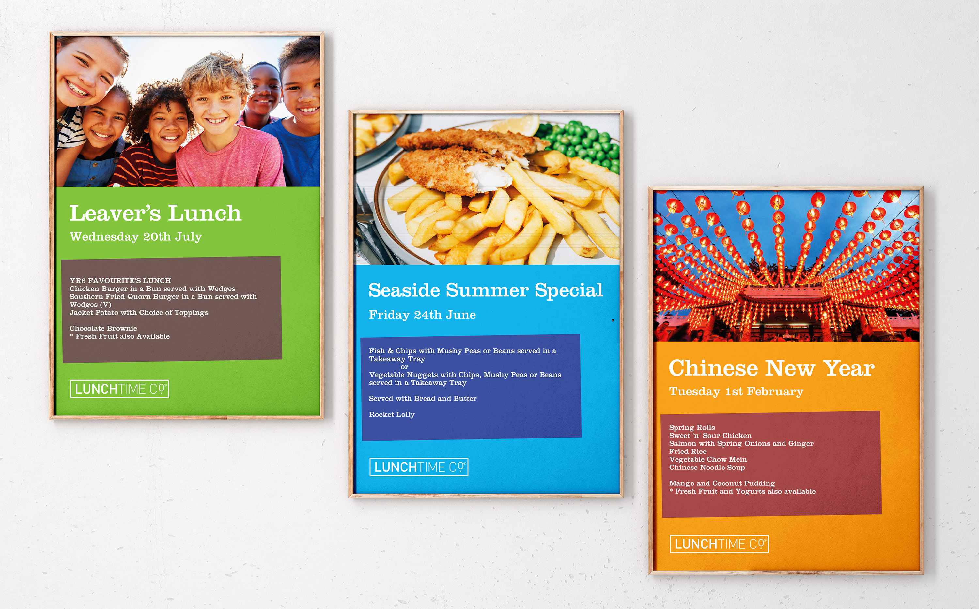
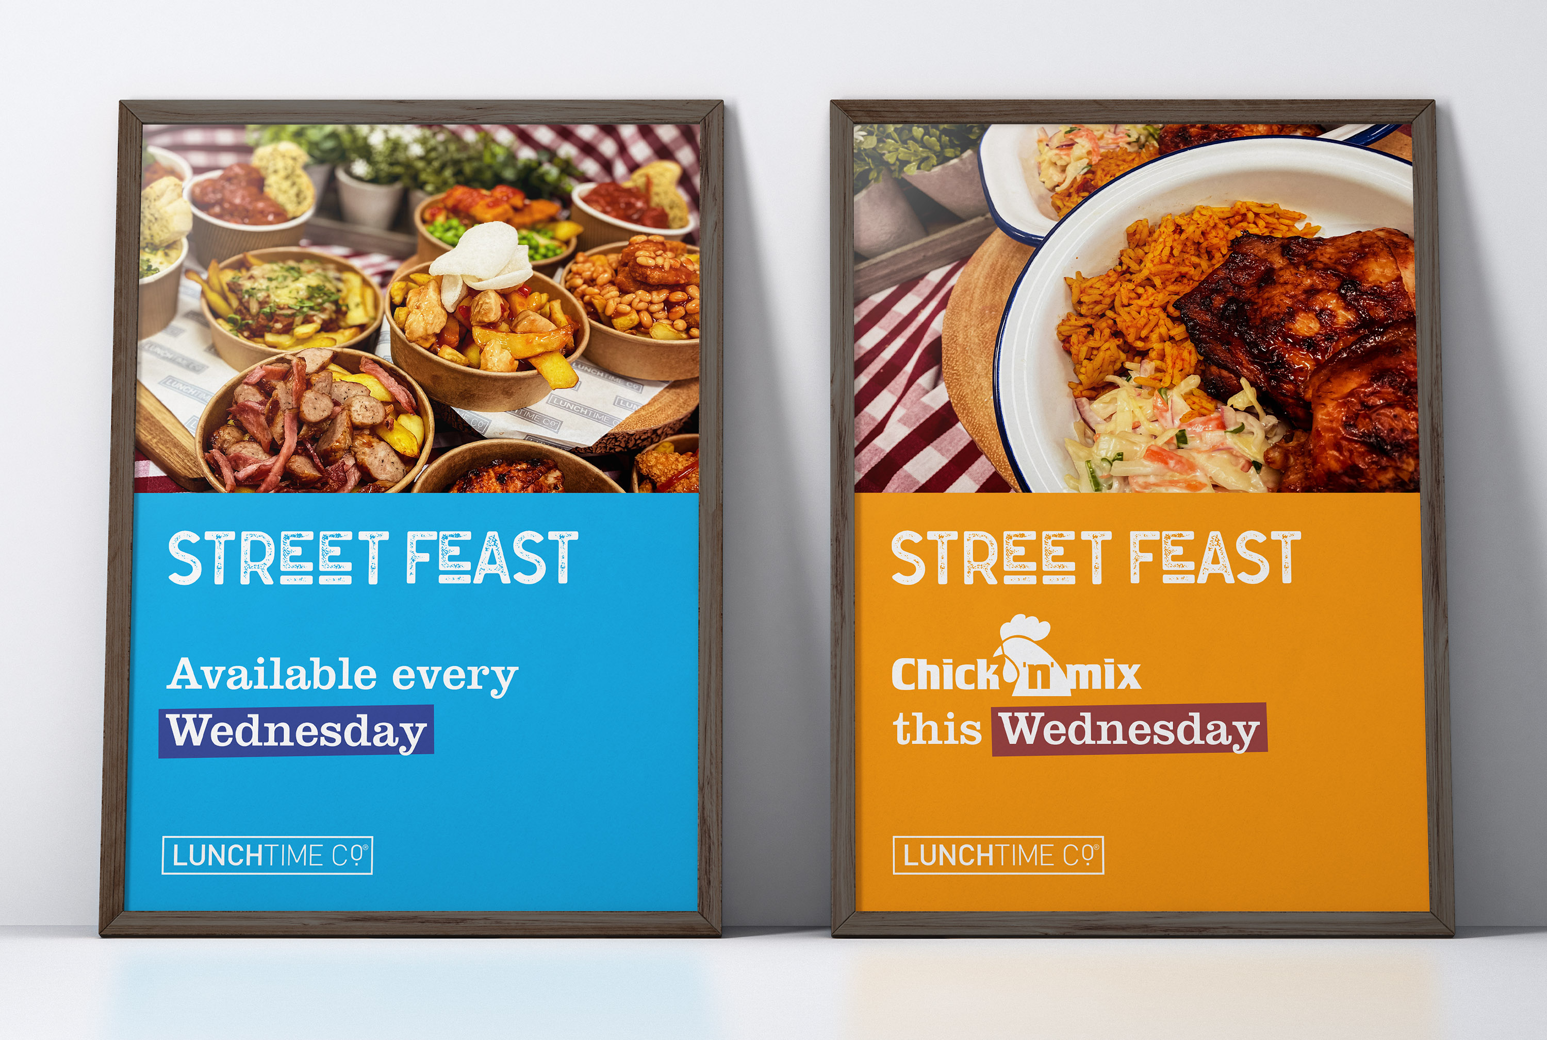
More than Lunchtime

Slide 7
Thank You
Making lunchtime the highlight of your day

