Slide 1

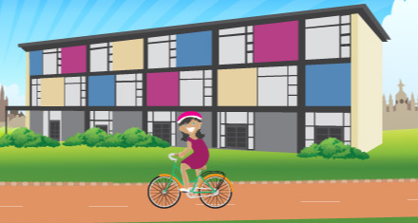
Welcome to
St Matthew’s Primary School
Notes:
Tony & Dean general welcome.
Introduce:
Christina
Poppy

Slide 2
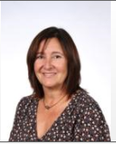
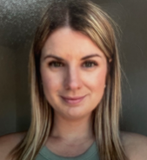

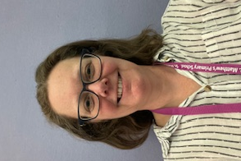
Familiar Faces - Office
Kerry Debbie Lucy Maria
office@stmatthews.cambs.sch.uk
Telephone – 01223 568838
Notes:
Thank you for coming this evening, it really is lovely to see you all and we are very excited to embark on this journey with you.
Our main aim this evening is for you to get to know us as a team, answer any questions you have and understand your child’s transition into st Matthew's . At the end of this presentation there will eb an opporintuy for you to ask any questions you feel may be pertinent to everyone.
Forstly – I would just like to intporoduyce to some fmailair faces that you will see in the Offcie – Kerry, Debbie, Lucy and Maria

Slide 3
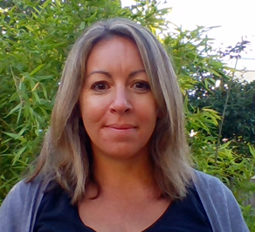
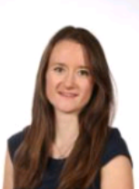
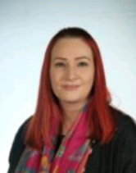
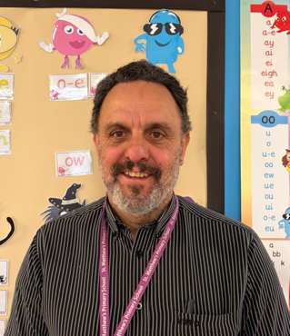
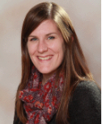
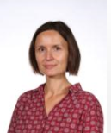
Our Reception Team
Mulberry | Cherry | Oak
Mrs Bushen & Mrs Harris (Monday-Thursday) (Friday) | Mrs Blackman-Doyle & Mr Orton Monday, Wednesday, (Tuesday) Thursday & Friday) | Mrs Sewell & Ms Argasinska (Monday-Wednesday) (Wednesday Friday)
Notes:
KATE
On the slide you will see all of the lovely Reception teachers –
Unfortunately, Mrs Harris and Mr Orton can’t be here this evening but we are hoping that they will be able to meet them at the Stay and Play session on Thursday 9th July 2026.
In a moment the teachgers will be talking through all the information you need to know before September. Just before I hand over to them I want to talk to highlight two things -

Slide 4

Attendance
We expect that all parents/carers will:
Make sure your child comes to school every day
Make sure your child arrives at school on time
School starts at 8:45am. Main gates open at 8:40am
Inform the school in advance of any medical appointments during school time. Parents may on occasion be asked to provide supporting information from the hospital, doctor or dentist, such as appointment details card/letter/text message in relation to the time requested. If possible, medical appointments should be arranged outside of school hours.
Contact school before 9am if their child cannot attend school and inform the school why they can not attend.
Notes:
As a school, we want to promote good attendance habits from an early age, and this starts in Reception.
On the screen, you can see some of the ways you can help support this.
Firstly, please make sure your child comes to school every day and arrives on time. The main gates open at 8:40am and the school day starts at 8:45am.
Secondly, where possible, please try to arrange medical appointments outside of school hours. If this isn't possible, please provide proof of the appointment to the school office.
There is a copy of our Attendance Policy on the school website, which explains our approach to attendance and requests for leave of absence. Please be aware that leave will only be authorised in exceptional circumstances.
By working together from the very beginning of your child's school journey, we can help establish positive attendance habits that will support their learning and progress throughout their time at school.

Slide 5
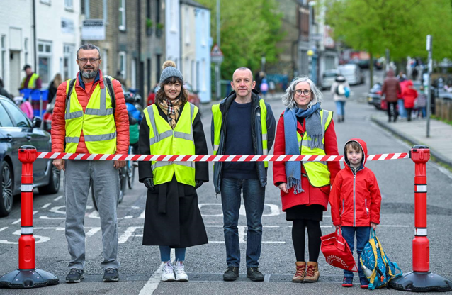
Your journey to school:
Norfolk Street is closed to cars at pick up and drop off times
(8:30am -9am and 3-3:30pm)
The road is closed from the junction with Staffordshire Street and Norfolk Street 8.30-9am and 3-3.30pm
If driving to school is unavoidable, please park a few streets away and walk the rest of the way
Please do not drive as far as the barrier, and please do not drive down Staffordshire Street, which is "access only" at all times
Please do not ask to drive through the closure, the volunteers will turn you away
If you require special permission to drive through the closure, please speak to the school office. Permission is unlikely to be granted without a very good reason.
If you are waiting in your car in the surrounding area, please turn your engine off.
Please note that the barrier will be in operation on stay and play days, so plan your journey accordingly. This might be a good opportunity to do a practice walk/cycle to school!
If you would like to find out more about volunteering with the barrier
team please email street@stmatthewspta.org,uk
Notes:
Finally – I have been asked by our school streets volunteers to share this information with you.
Please be aware that Norfolk Street is closed to cars at pick up and drop off
They are always looking for more volunteers too so if you are interested, please email them.
I am now going to hand over the to teachers who are going to talk to you about what t is like in Reception and what is going to happen between now and September.

Slide 6
Our School Values
Co-operation
Responsibility
Perseverance
Integrity
Self awareness
Assertiveness
Enthusiasm
Kindness
Empathy
Forgiveness
Thankfulness
Respect
Curiosity
Creativity
Independence
Notes:
Marie-
As a school, we have chosen values that we think support the children to have happy, positive, fulfilling lives. We aim to support your child’s educational journey through encouraging, curious and confident children who are willing to embrace challenge, and try new experiences.
What we want to achieve is that children learn to use the values in their day to day lives. Each week, we learn the meaning of a new value and explore the meaning in real life situations so that the children can begin to embed the meaning of each value! These values are taught across the whole school, throughout the year. creating a positive and respectful ethos and encouraging the children to understand the importance of being respectful and empathetic towards each other, whilst developing a resilient approach to their own learning.

Slide 7
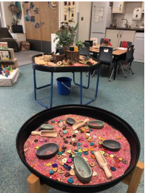
Your child’s learning
* Follows EYFS Curriculum – Continuation from Nursery
* Play based curriculum
* “Busy Learning”: independent learning
* Whole class
* Small group
One to one
Outside
Notes:
Marie- Learning in Reception takes many different forms. In Reception, the children follow the EYFS. This is a continuation from what the children have been doing in Nursery and helps prepare them for the National Curriculum in Y1.
There is whole class teaching, small group teaching and some one to one teaching. It is a play based curriculum which has been carefully designed to support all learners.
An important aspect to the Reception experience is independent learning. This is when the children have a chance to embed what they have learnt independently through carefully organized learning opportunities both inside and outside the classroom.
Learning through play is highly valuable and we call this ‘busy learning’ when we talk about purposeful play with the children.

Slide 8
A Typical Day in Reception
Whole class
Phonics
Outdoor teaching and learning
Busy learning –independent learning (inside and outside)
Guided Reading – small groups
Story time
Snack time – twice a day
Whole class teaching
Playtime
Lunchtime
Notes:
Sarah
Here is a typical day in Reception…. As you can see the day is full and busy. We do realise that for many children starting school this year is a HUGE step and we will be easing them in gently but please don’t be alarmed if your child comes home tired and irritable as it is a busy day.
You will have noticed that we do phonics every morning. Mrs Sewell is going to talk to you about this in more detail.
.

Slide 9

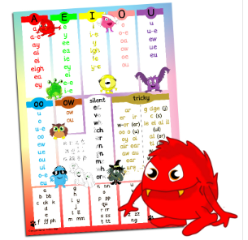
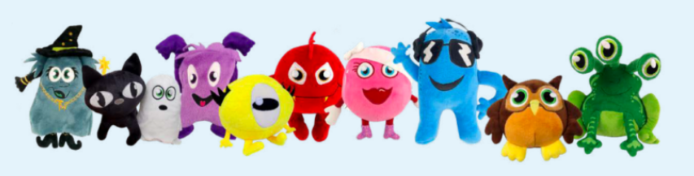

Phonics - Learning to read and write
Notes:
Sarah -
Learning to read and write - We teach phonics daily at St Matthews.
We teach phonics through an exciting scheme called Monster Phonics. Monster Phonics helps children to learn and recall spellings by using colour. Each sound and colour is also represented by a monster that makes that sound (a sound cue). This brings phonics to life and makes Monster Phonics highly engaging. .This approach to phonics is fun and gives the children the tools and strategies to become independent readers and writers.
In the Autumn Term, there will be the opportunity for you to attend a parent webinar to learn more about how you can help support your children. There is also a great facebook group that you can join if you are on facebook.
We love teaching phonics here and the children love learning phonics too. We are careful to make the link between ‘doing’ phonics every day, alongside developing a love of books, reading and writing.
Children will bring books home from school in their red book bags and we encourage you to share these books with them in a positive and encouraging manner. Initially, you may read the books to your child, talk about the pictures and then as the year progresses, your child will begin to want to read their reading books to you and show off their newly acquired reading skills.

Slide 10
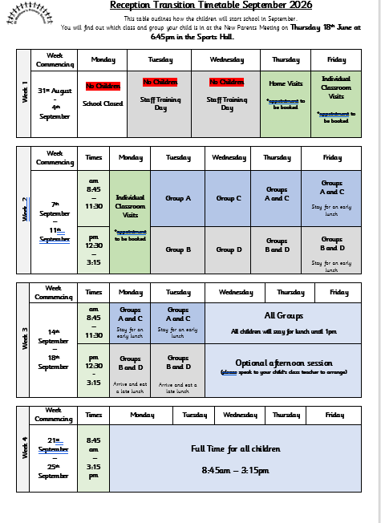
Transition
Stay and Play visits…
Tuesday 30th June (3:30-4:15pm)
Thursday 9th July (3:30-4:15pm)
Home Visits or Individual Classroom visits to your child’s classroom in September
Small Groups
Notes:
Karolina -
Moving on to September - It is really important to get the transition into Reception right.
We want to get to know your child and for them to get to know us, and explore their exciting new environment. If your child does not feel safe and secure they are not going to learn. This is one of the main themes which underpins the Early Years Foundation Stage and is crucial to get right.
You will have already received the times for the Stay and play dates via email prior to this meeting. Please do come along!
In your pack you also have the transition timetable. You will see that the first few days in September are for individual home or classroom visits. After a successful year of classroom visits we wanted to allow parents to decide which they would prefer. There are advantages to both, so please think carefully about what your child would benefit from the most. You will be able to sign up one of these in the classrooms shortly. You receive your time and date at the stay and play session later this term.
In September, your child will start school in a small group (A-D) (also in your pack) and we will build up the time spent in class ie they will begin to stay for lunch and mix with other groups. Please remember to get in touch with Poppy at the Kids R Us CLUB if you need any childcare arrangements in the first few weeks.

Slide 11
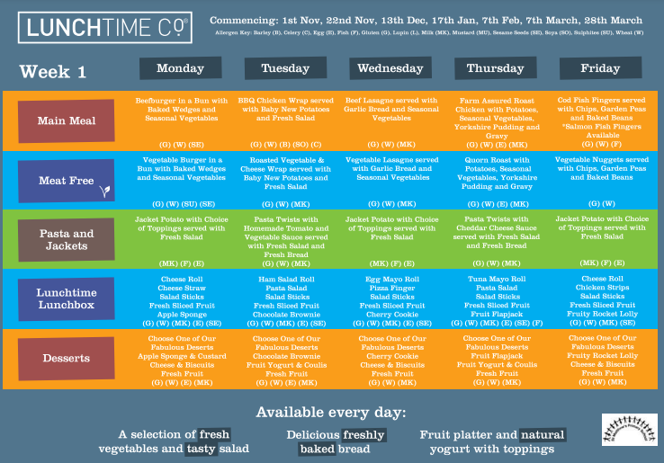

Lunchtimes
Notes:
Karolina - Our Reception children will be eating their lunches in the school hall. They will be supervised with their class teacher and TA initially and by a lunchtime supervisor will become a familiar face to the children.
School menus will be available online for you to share with your children and the children will have a choice between a hot lunch or cold lunch.
If your child would prefer to bring in a packed lunch from home, please let your child’s class teacher know on the day. Please be aware we are a nut free school.
It is very important that you inform the school if your child has any dietary requirements or allergies. Please write it on your child’s admissions form.

Slide 12
Top Tips
* Bring in your child’s birth certificate or passport and admissions form before Friday 17th July.
* Encourage Independence – coats, shoes, toileting
* Be positive about school
* Boost your child’s self esteem
Play dates
Look at the Early Years Section on the school website
What your child needs to bring in September
Daily: water, fruit, book bag
To be kept at school: wellies, a rain coat, small bag with change of clothes
We will let you know when PE will start. The children come dressed in their PE kit.
Name Everything!
Notes:
Ashleigh
We have compiled a list of some of our top tops things to do before your child starts with us in September.
This evening, you will have received a road to school poster. This has some really great suggestions of things to do in preparation before starting school. Please do take the time to look at this.
In addition to this…. Some are other top tips are:
Please complete the admissions form and bring in your child’ birth certificate/passport before Wednesday 23rd July.
Encourage independence – one of the big changes from going from Nursery into Reception is the adult to child ratio. If you can help your child to be as independent as possible with dressing and undressing and also personal toilet hygiene this will help them to settle much quicker at school. We do not have a school uniform at ST Matthew’s but please think carefully about what you are putting your child in to wear. Big chunky zips on coats are always very helpful in the Autumn/Winter term
Be positive about this exciting next step and please think carefully about how you are talking about school e.g. big school can be daunting to small children. We often use the the phrase joining St Matthew’s, New school or Mulberry class etc.
Praise your child for small achievements which we take for granted e.g. putting coat on, getting things ready for school, sharing, tidying up – all skills which they are going to need in a class of 30.
Start to arrange play dates - Now you know who is in your child’s class and you will be able to meet a few of these parents at the stay and play sessions at the end of this term, try and arrange some play dates throughout the summer – Could you set up a Whats App group for the new Reception children, and in September you will receive information about the Class Lists which is another way of communicating with each other in your class. I strongly recommend trying to meet up over the Summer, especially if your child is coming from a setting by themselves.
Finally, In September, your child will need to bring a named water bottle, piece of fruit or veg every day. Once they start with us, we will give them their bookbag. As the children go out in all weathers, it is really useful to have a spare pair of waterproofs and wellington boots to be kept at school. We will let you know when you will need to bring in a PE kit.
Naming – importance, children’s responsibility to look after their own possessions and we try and encourage children to not bring any toys or items from home in, especially if they are precious as things get easily lost

Slide 13
Working Together
Weekly information sheets
Parent Consultations
Stay and play sessions
Main gate
Communication
Google Classrooms
Punctuality – School starts at 8:45am
Attendance
Email child’s teacher/s
Notes:
Ashleigh -
Finally, we just wanted to highlight some of the ways that we can communicate together.
Every week you will receive a Weekly Information Sheet. This has an overview of what the children are learning, and ways you can help at home. These will all be sent out of eschools which you will automatically get signed up to in September. Both parents will receive this information. This can often be a great way to start conversation with children at home because inevitably they will say they have not done anything at school. We will also be using google classrooms to share some of the curriculum highlights each half term too. You will find out more information about this in September.
The beginning and end of the school day is often quite busy for the teachers, but if you do need to speak to them, please either email the school office or the teachers directly and they will arrange a meeting. Often a telephone call is better than a lengthy email but please do reach out to us if you need to talk something through, even if you think it is something small. If we don’t know, we can’t resolve it.
Parents Consultations – There are two parent consultations – one in October and one again in February. AT the end of the academic year you will receive a written report.
Each term there is a Stay and Play session where you get the chance to come into school and see their books.
Finally – please do make sure you communicate with us. If your child is unwell, please let the office know before 9am each day that they are off and come and talk to us, no matter how small your query is. If we don’t know, we can’t help.

Slide 14

Thank you for coming.
Please come and visit your child’s classroom.
Notes:
Kate -

