Slide 1
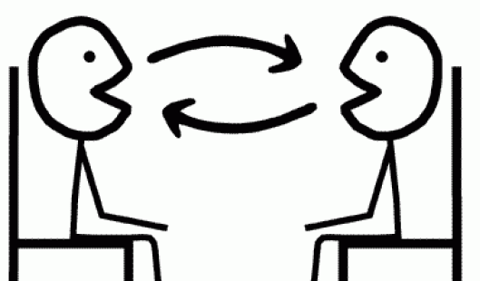
Dear Children,
This week’s work is the same as last week’s. You just need to answer the questions on slide 3.
You will also find the answers from last week’s work on slide 4 . Au revoir!
Révision!
Notes:
This lesson is about consolidating all the language learnt so far about music, likes, dislikes and reasons and bringing it together so that pupils end up being confident in have a short exchange of up to a max. of 6 questions and answers. We are going to begin with some game activities to rehearse the language they have met, develop fluency, memory, pronunciation and confidence in speaking.

Slide 2
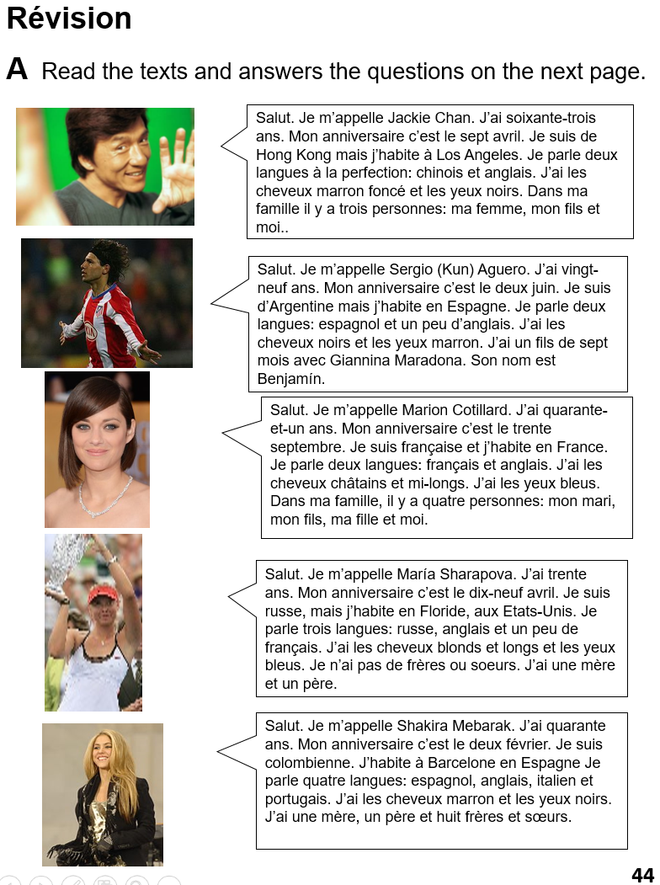
B Read the texts again.
Write down or highlight all the words you know.
1
2
Then answer the questions on the next slide.
3
4
5

Slide 3
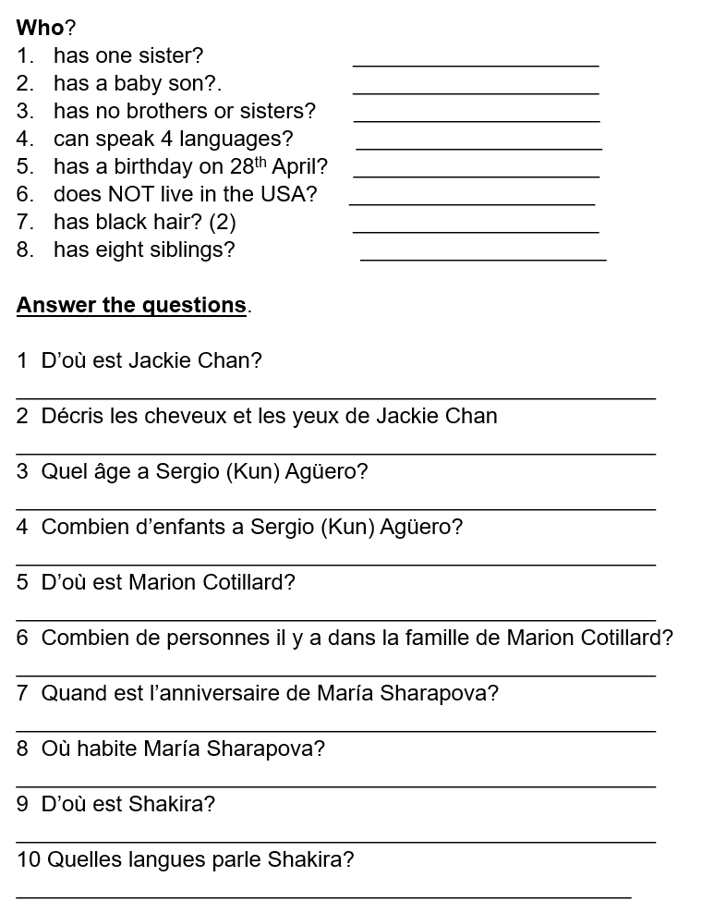
Word bank
D’où – where from?
Décris: describe
Combien: how many
Quand: when
Quelles: which/what (plural)
Answers: on the next slide.

Slide 4
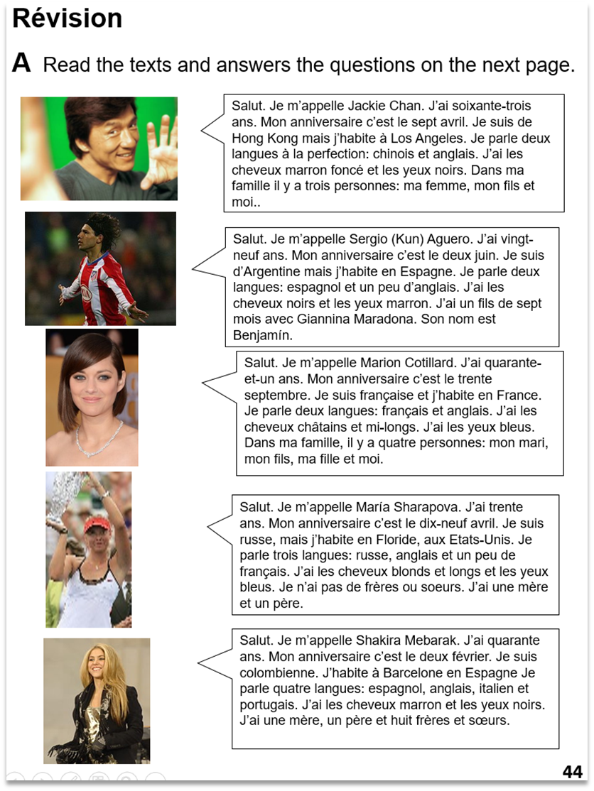
2
4
5
Word bank
D’où – where from?
Décris: describe
Combien: how many
Quand: when
Quelles: which/what (plural)
???
2
2
5
Hong Kong
Il a les chevaux marron et les yeux noirs.
Vingt-neuf, 29
1 enfant
Elle est française
4 personnes
Le dix-neuf avril
En Floride
Elle est colombienne
Espanol, anglais, italien et portugais

